Slide 1
Nuclear Magnetic Resonance
Brien Fries
Period #2
May 27th, 2016

Slide 2
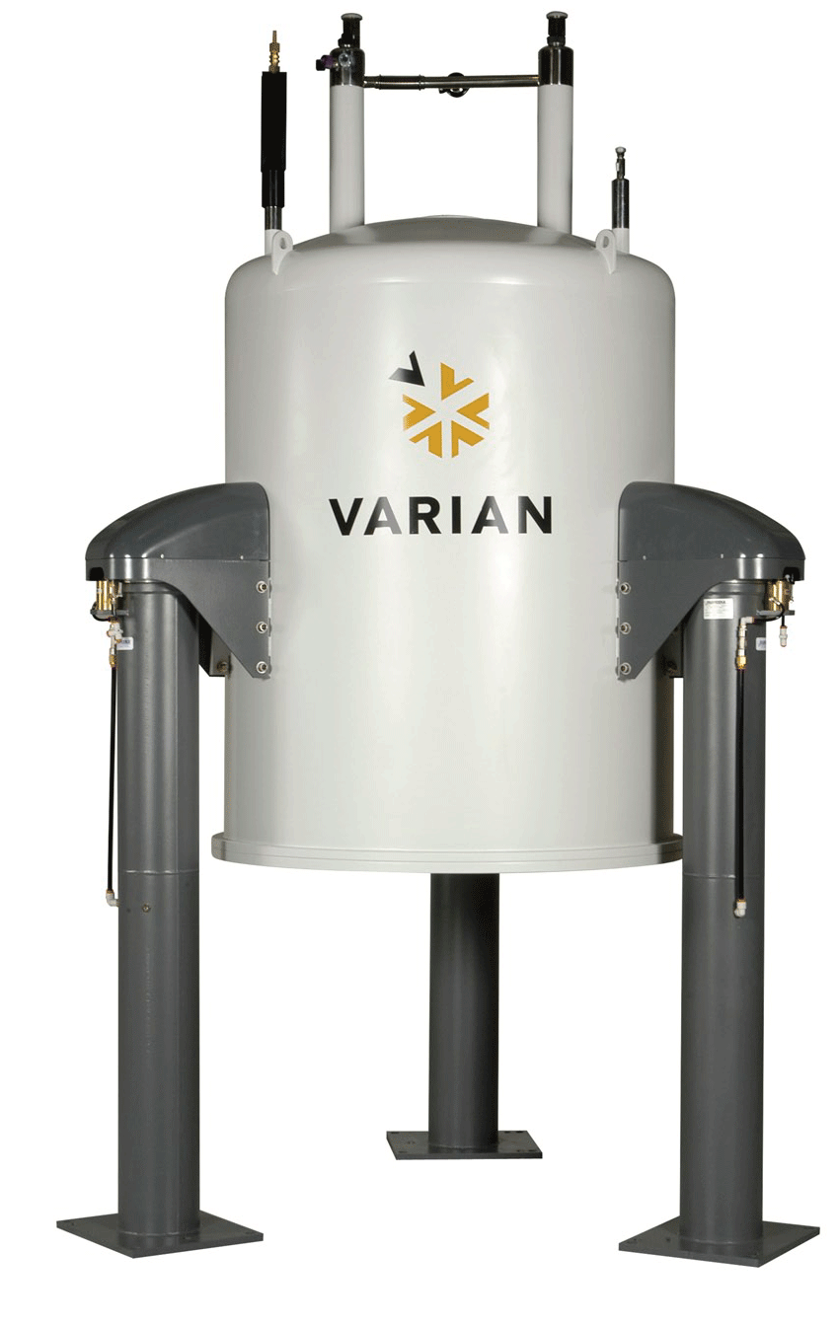
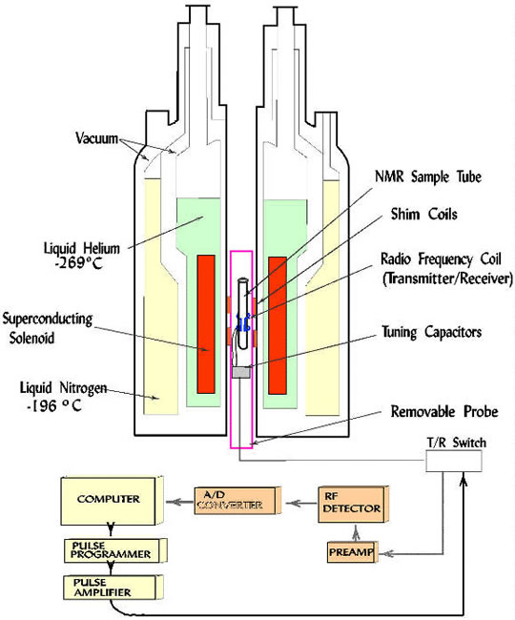
Diagram

Slide 3
Step by Step
Prior to analysis:
-Make up slightly more sample than required.
-Pack a small piece of cotton/glass wool tightly into a Pasteur pipette and wash with small amount of solvent.
-Filter solution into NMR tube.
Due to the fact that this instrument relies on a computer to see the process and final results of the unknown/known sample, a computer is needed to be installed to the monitor being used. Once downloaded, you begin by running the ‘insert new sample’ program.
Place your NMR tube in a sample holder which also measures the level of solvent. This sampler holder will then be pushed through the top and allowed to drop into the center of the instrument.
Pick experiment that will be performed through computer (Ex: Proton 8 NMR)
After time of developing, the computer will create the read out of the sample’s included elements along with its physical and chemical properties (not manually)

Slide 4
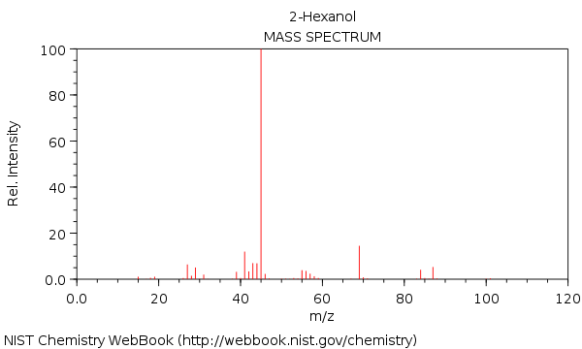
Step by Step
Ex:
Proton 8 of Hexanol

Slide 5
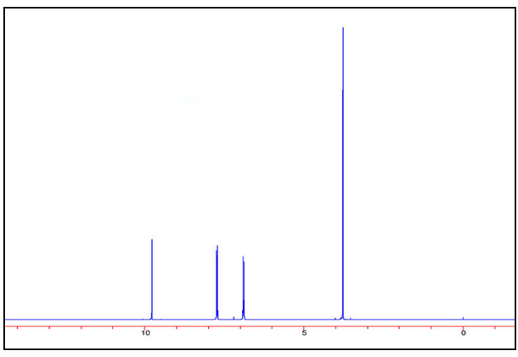
Chromatogram/Sample Analysis
How many distinct sample resonances are there in the spectrum to the right? (Answer: four)
What type of proton is the peak at 3.77 ppm most likely due to? (Answer: -OH or -O-CH)

Slide 6
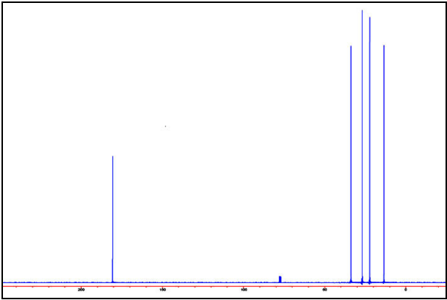
Chromatogram/Sample Analysis
3. What is the peak at 180.6 ppm due to?
(Answer: COOH. Carboxylic acid carbons resonate between 160 and 180 ppm)

Slide 7
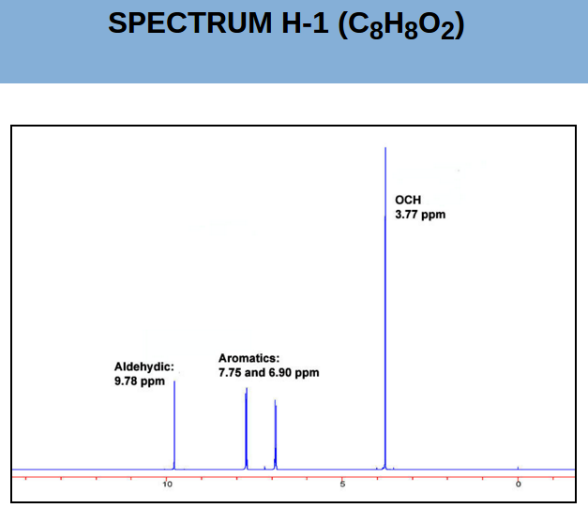
Practice Examples
1. What is the substitution pattern on the benzene ring?
Mono-
Orhto-
Meta-
Para-

Slide 8
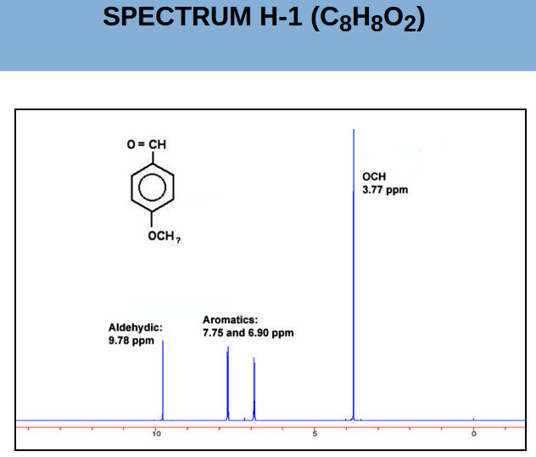
Practice Examples
2. Given the empirical formula and the structure shown at right, how many protons must be present on the OCH?
None
One
Two
Three

Slide 9
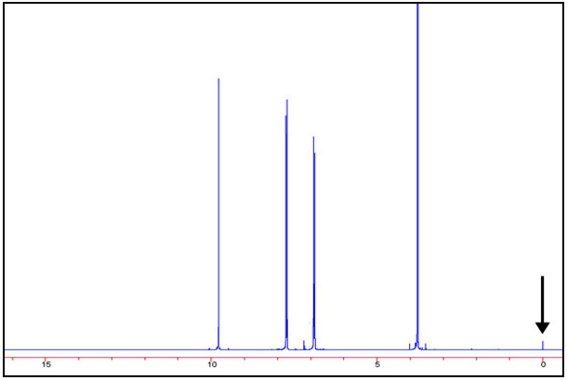
Practice Examples
3. What is the identity of the small peak at 0 ppm?
Solvent
Tetramethylsilane chemical shift reference
Sample impurity
Instrument artifact

Slide 10
Practice Examples Solutions
Answer: (d) - substitution (with two different substituents) leads to two aromatic resonances
Answer: (d) - clearly three because it is an OCH₃ group.
Answer: (b) - this peak is due to the chemical-shift reference, tetramethylsilane, (CH₃)₄Si. Unless the sample contains silicon or is organometallic, chemical shifts do not appear in this range.

Slide 11
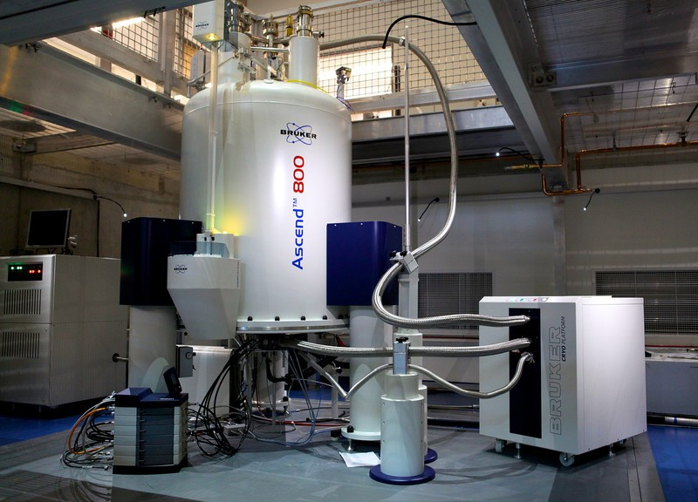
Industry
Nuclear Magnetic Resonance is a chemical phenomenon that can serve almost every industry chemically based (which is almost all of them). NMR indirectly benefits all businesses using chemicals due to the fact that it can determine unknown chemicals in a compound. Once those chemicals are discovered, it then describes their physical and chemical properties.

Slide 12
