Slide 1
Gas Chromatography
An analytical instrumentation process

Slide 2
What is gas chromatography?
Chromatography is a technique for separating chemical substances that relies on differences in partitioning behavior between a flowing mobile phase and a stationary phase to separate the components in a mixture.
Gas chromatography is a type of chromatography used to analyze volatile substances in the gaseous phase.

Slide 3
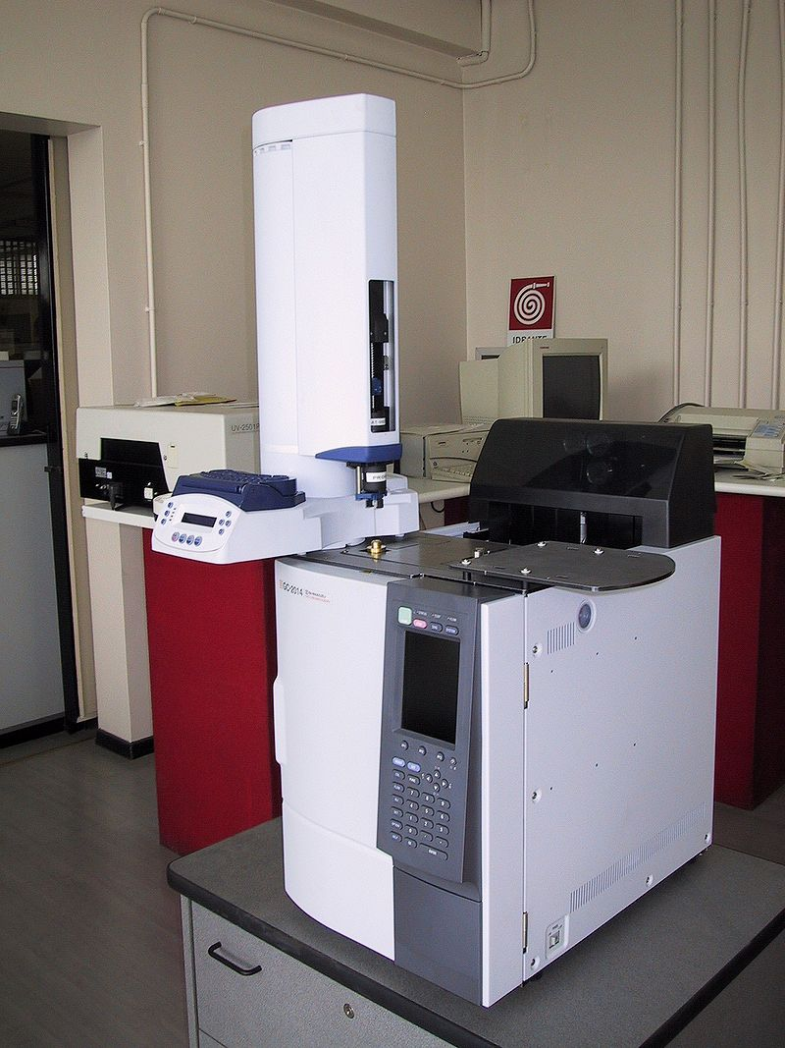
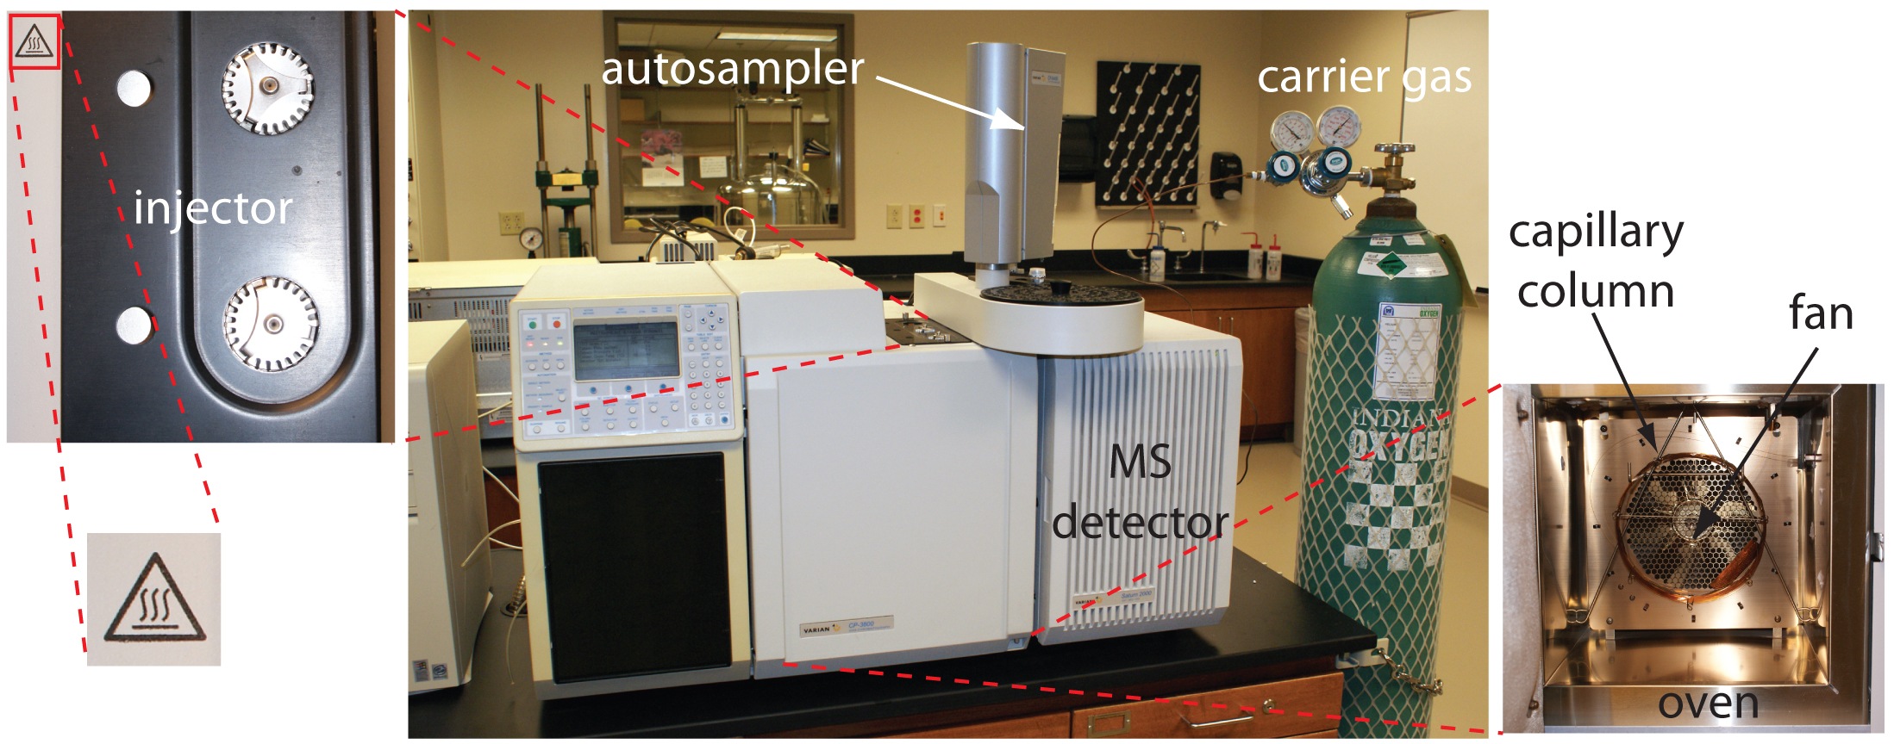
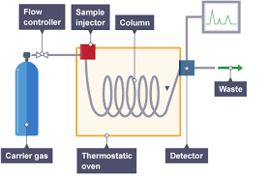
Diagrams

Slide 4
Basic Terms
In GC, the mobile phase is a chemically inert gas (often helium or nitrogen) that carries the molecules of the analyte through the heated column.
The stationary phase is either a solid absorbant (in which case gas-solid chromatography, GSC, is being performed) or a liquid on an inert support (in which case gas-liquid chromatography, GLC, is being performed).
The solution sample is placed in the injector, or sample port, where it is heated to vaporization by the oven. The vaporized solution then travels through the column.
The oven is the thermostated device which heats the column and injector. In can be operated either through isothermal programming or temperature programming.

Slide 5
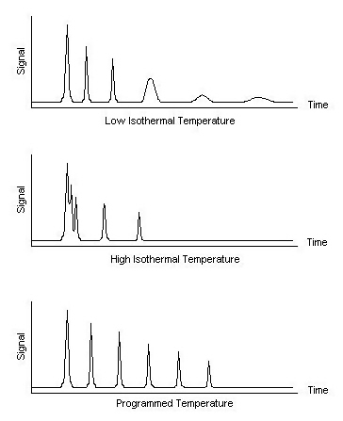
In the isothermal programming method, the temperature of the column is held constant throughout the entire separation. The optimum temperature represents the approximate midpoint of the boiling range of the sample. However, isothermal programming only works if the boiling point range of the sample is narrow.
In the temperature programming method, the column temperature is either increased continuously or in steps as the separation progresses. It is used for samples in which the boiling point range is wide.

Slide 6
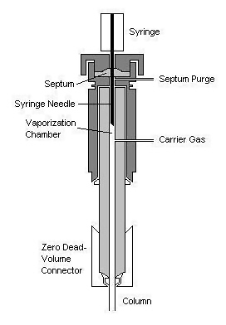
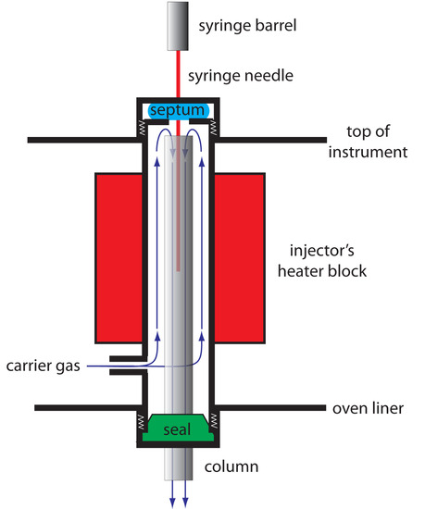
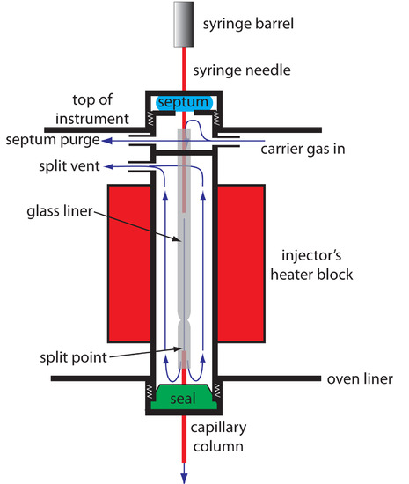
Injector Schematics
Direct injector
Injector for use with
packed columns
Injector for use with
capillary columns

Slide 7
Basic Terms Cont.
The column is the narrow tube where the separation of the solution components occurs.
-There are two types of columns: packed columns and capillary columns.
Detectors are devices attached to the column that analyze the separated sample in various ways.

Slide 8
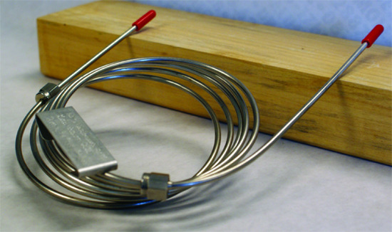
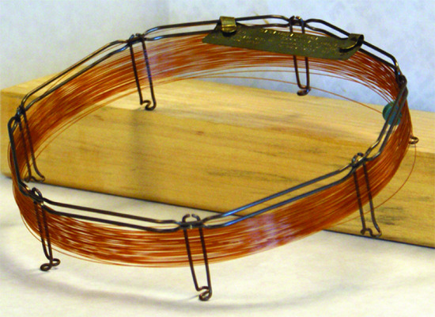
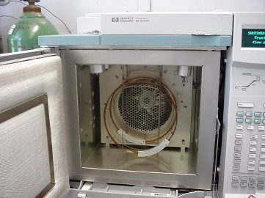
Packed Column
Capillary Column
Capillary column in oven

Slide 9
Capillary Columns
Capillary columns, or open tubular columns, are made of fused silica and are coated with a protective polymer coating. Columns range from 15–100 m in length with an internal diameter of approximately 150–300 μm.
Capillary columns can be organized into three different types. In a wall-coated open tubular column (WCOT) a thin layer of stationary phase is coats on the capillary’s inner wall. In a porous-layer open tubular column (PLOT), porous solid support (typically, alumina, silica gel, and molecular sieves) is attached to the capillary’s inner wall. A support-coated open tubular column (SCOT) is a PLOT column that includes a liquid stationary phase.
Capillary columns are used to perform separation quickly and efficiently, but only work for small samples.

Slide 10
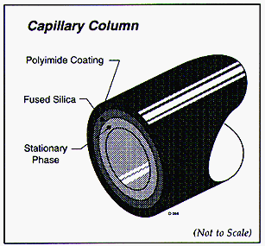
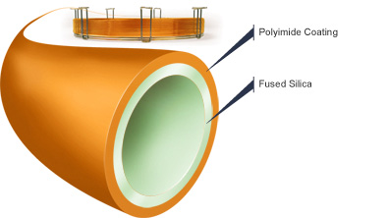
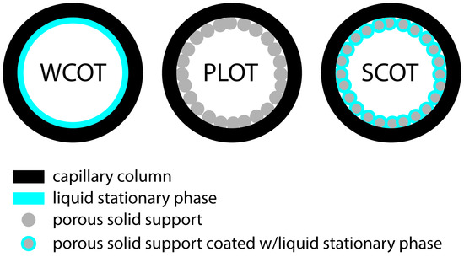

Slide 11
Packed Columns
Packed columns are constructed from glass, stainless steel, copper, or aluminum, and are typically 2–6 m in length with internal diameters of 2–4 mm. The column is filled with a particulate solid support (generally, liquid-coated silica particles), with particle diameters ranging from 37–44 μm to 250–354 μm.
The most widely used particulate support is diatomaceous earth, which is composed of the silica skeletons of diatoms.
Packed columns can analyze large samples, but are slow and inefficient.

Slide 12
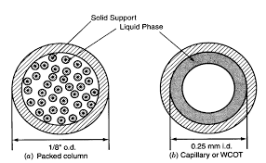
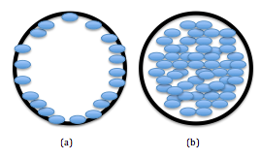
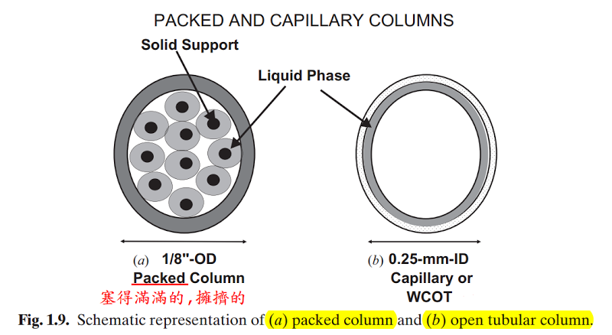

Slide 13
Detectors
There are numerous different types of detectors that have different applications.
We will focus on flame ionization detectors, the most common type.
Other detectors include quadrupole ion-trap analyzers, thermal conductivity detectors, electron capture detectors, atomic emission detector, GC chemiluminescence detectors, photoionization detectors, and mass spectrometers.

Slide 14
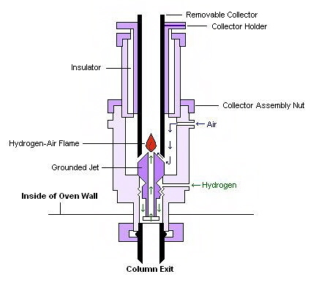
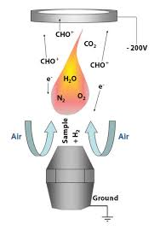
Typical Flame Ionization Detector Schematics

Slide 16
Flame Ionization Detectors
In FID, a sample is exposed to a hydrogen-air flame after exiting the column.
The high temperatures of the hydrogen-air flame cause the sample to undergo pyrolysis, chemical decomposition from intense heating.
Decomposed hydrocarbons release ions and electrons with current.
A high-impedance picoammeter measures this current to record the sample’s elution.

Slide 17
Description of Analysis
Preparation of Sample
The sample (or analyte) must be in liquid phase and must have a “medium” concentration (not too low or too high). If the concentration is too low, the solution will not give an adequate signal. If the concentration is too large, the column can be easily overloaded, resulting in peak fronting.
Additionally, the sample must have volatile constituents. A solution of low volatility may remain in the column. A nonvolatile solution will condense at the top of the column, degrading the performance. Generally, volatility is guaranteed by extracting a solution’s nonvolatile elements from its volatile ones or making nonvolatile elements volatile.

Slide 18
Injecting the Sample
3. In order to transfer the sample into the apparatus, a syringe is used. Specifically, the sample is injected through a rubber spectrum using a microliter syringe.
4. The injector heats the sample to evaporation.
Column Chromatography
5. The evaporated sample enters the column.
6. The sample separates based upon the polarity of the constituent compounds and their resulting attraction or lack thereof to the stationary phase.
7. The oven heats the column to keep the separation going.

Slide 19
Detection
8. The difference constitutes exit the column in segregated bands, entering the detector.
9. In the case of a flame ionization detector, the sample is exposed to a hydrogen-air flame in the detector.
10. Pyrolysis occurs, and a precise picoammeter measures the subsequent election flow, recording a chromatogram based on signal strength.

Slide 20
Analyzing Gas Chromatograms
Gas chromatograms provide three different types of information.
The number of compounds in the mixture is represented by the number of peaks.
The ratio of moles of each compound to each other can be found by calculating the areas under the curves and comparing them.
The retention time (the amount of time that a substance takes to pass through the column) of a compound in the mixture is indicated by the position of the peak. Since the x-axis represents time (while the y-axis represents the strength of response), peaks closer to the y-axis (farther to the left) represent the smallest retention times, and peaks moving to the right represent increasing retention times.

Slide 21
The longer the retention time of a compound, the greater affinity it has for the stationary phase. Applying the principle that “like attracts like”, we can reach conclusions about the polarity of different analytes (compounds in the sample) based upon the polarity of the stationary phase. In other words, because polar molecules attract polar molecules and nonpolar molecules attract nonpolar molecules, we can determine whether or not an analyte is nonpolar or polar based upon how long it stays in the column.
Because boiling point is related to polarity, the order of retention times loosely correlates to the order of boiling points, either from high to low or low to high, depending on the polarity of the stationary phase.

Slide 22
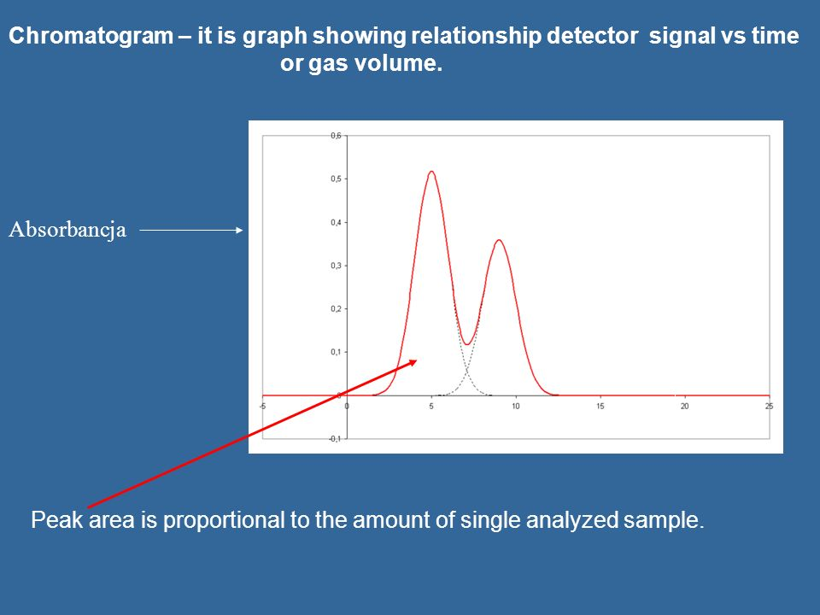
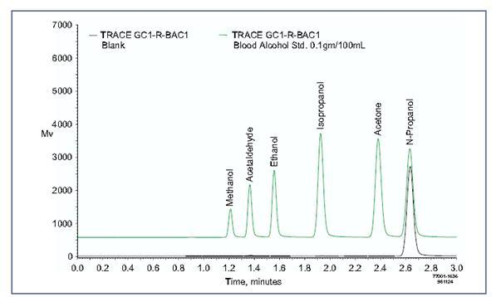
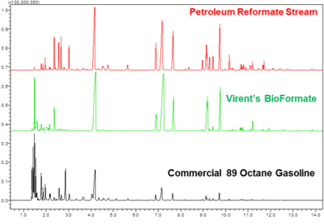
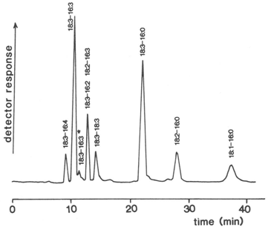
Examples of Chromatograms

Slide 23
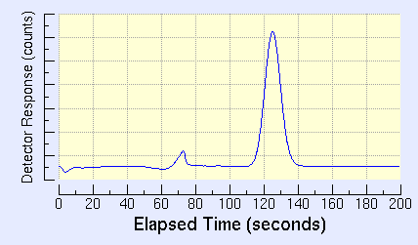
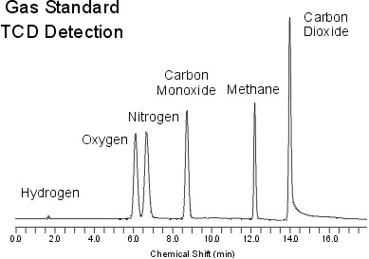
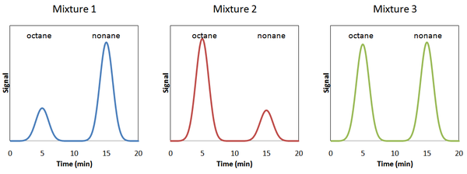
Practice Chromatograms

Slide 24
Applications
area | applications
environmental analysis | Green house gases (CO2, CH4, NOx) in air pesticides in water, wastewater, and soil vehicle emissions trihalomethanes in drinking water
clinical analysis | drugs blood alcohols
forensic analysis | analysis of arson accelerants detection of explosives
consumer products | volatile organics in spices and fragrances trace organics in whiskey monomers in latex paint
petroleum and chemical industry | purity of solvents refinery gas composition of gasoline

Slide 25
Application Cont.
GC is used in various ways:
Food analysis, particularly in analyzing dairy rancidity.
Measuring the presence of pollutants like DDT, formaldehyde, and carbon monoxide and in ecology and environmental science.
Alcohol quality measurement.
Blood alcohol level measurement and general blood analysis (determining what drugs are present and in what quantities).

Slide 26
Bibliography
"Gas Chromatography." Chemwiki. 2013. Web. 27 May 2016. http://chemwiki.ucdavis.edu/Core/Analytical_Chemistry/Instrumental_Analysis/Chromatography/Gas_Chromatography
"12.4: Gas Chromatography." Chemwiki. 2013. Web. 27 May 2016. http://chemwiki.ucdavis.edu/Core/Analytical_Chemistry/Analytical_Chemistry_2.0/12_Chromatographic_and_Electrophoretic_Methods/12.4%3A_Gas_Chromatography
"Gas Chromatography | HiQ." HiQ. Web. 27 May 2016. http://hiq.linde-gas.com/en/analytical_methods/gas_chromatography/index.html

