Slide 1
Gel Electrophoresis
By: Sariah Arnold

Slide 2
Definition
Gel Electrophoresis - a laboratory method used to separate mixtures of DNA, RNA, or proteins according to molecular size.
In gel electrophoresis, the molecules that are to be separated are pushed by an electrical field through a gel that contains small pores.

Slide 3
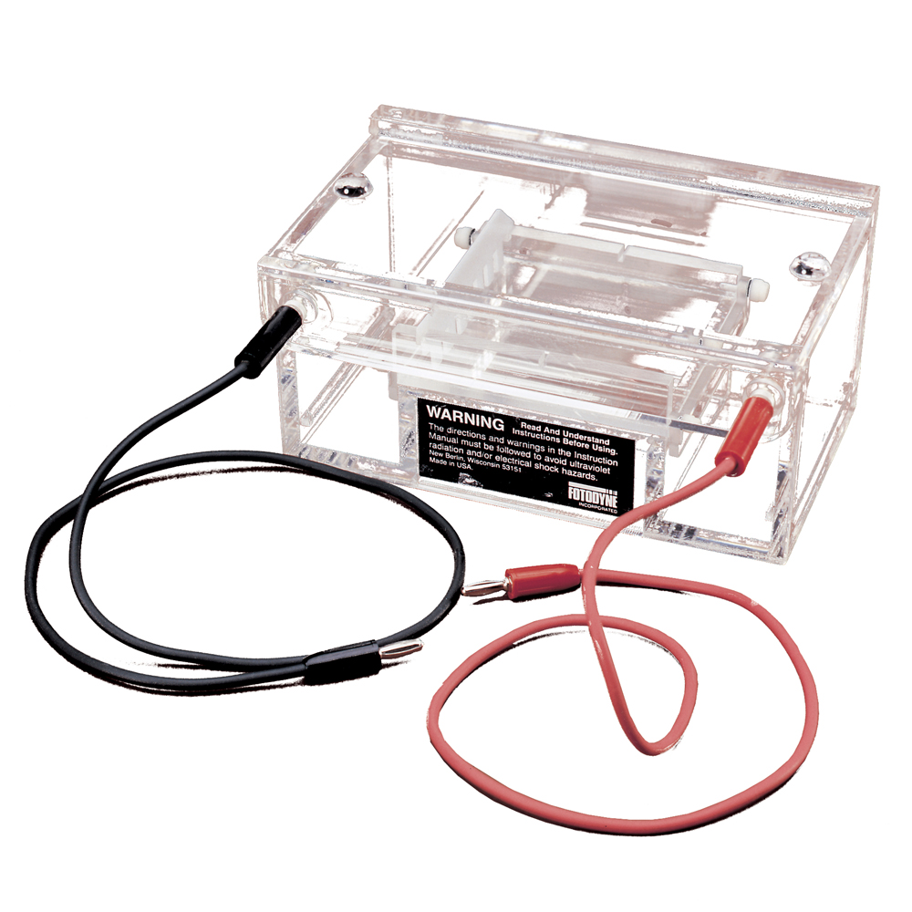
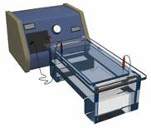
Gel Electrophoresis Chamber

Slide 4
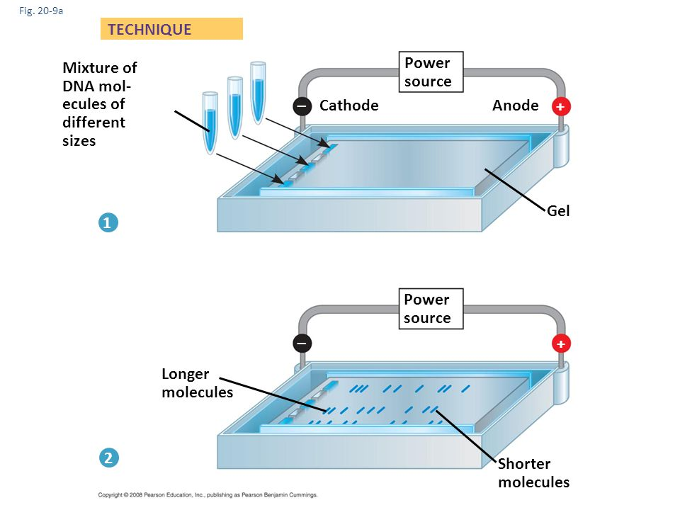
Inside the Electrophoresis Box

Slide 5
How To Use Gel Electrophoresis to Analyze a Sample
Make the Gel
Set Up the Gel Apparatus
Load the DNA Sample Into the Gel
Hook Up the Electric Current and Run the Gel
Stain the Gel and Analyze the Results

Slide 6
Making the Gel
Materials:
Powdered agarose
a dried powder similar to gelatin but made from seaweed
Buffer
salt water solution; allows electrical charges to flow through the gel
Flask
Microwave
Gel mold
Gel comb

Slide 7
Making the Gel
Put small amount of agarose into flask.
Add liquid buffer to the to the flask.
Loosely plastic wrap the flask to prevent the liquid from boiling over.
Place flask into microwave.
Heat mixture until the agarose melts into the buffer.
Remove flask from microwave and remove plastic wrap.
Pour melted agarose mixture into mold (mold has tape on each end to hold in melted agarose).
Place gel comb into the gel at one end (the notches in the gel mold hold it in place).
Let gel cool and solidify (as gel cools, tiny holes will form in it).
Carefully remove comb, leaving empty wells for the DNA samples.

Slide 8
Set Up the Gel Apparatus
Materials
Gel
Electrophoresis Box
Buffer

Slide 9
Set Up the Gel Apparatus
Pour buffer into electrophoresis box
Remove tape from ends of gel mold
Place gel (still in the mold) into the electrophoresis box (just barely submerged in buffer)
Buffer conducts electrical current from one end of the gel to the other.
Keeps gel from drying out during the experiment.

Slide 10
Load the DNA Sample Into the Gel
Materials
Electrophoresis box containing buffer and gel
Micropipette
Pipette tips
Loading buffer
DNA sample
DNA size standard

Slide 11
Load the DNA Sample Into the Gel
With a clean pipette tip, use the micropipette to suck up some loading buffer, then add it to the DNA sample
DNA samples are prepared in a clear liquid solution that would be hard to see if you tried to load it directly into well. The loading buffer contains a dye that makes the sample easy to see. It’s also slightly goopy. This makes the DNA sample thicker. DNA size standard already contains loading buffer.
Use the micropipette to transfer the DNA sample from the tube into the well of the gel.
Use micropipette to transfer the DNA size standard from the tube into the well of the gel.
DNA size standard contains DNA strands of known lengths. Running it on the gel will give you a reference by which to estimate the lengths of the DNA strands in your sample.

Slide 12
Hook Up the Electrical Current and Run the Gel
Materials
Electrophoresis Box
Power Supply

Slide 13
Hook Up the Electrical Current and Run the Gel
Plug cords into corresponding outlets on the power supply and the electrophoresis box.
When you turn on the power, the black end will generate a negative charge. The red end will generate a positive charge. Together, they will pass the current through the gel. DNA has a negative charge. To move the DNA through the gel, you must put the black cord - the negative charge - closest to the wells.
Turn on power supply.
The gel is now running.
Check for tiny air bubbles coming out of the electrodes at both ends of the electrophoresis box.
proof current is running
Repelled by the negative charge, the DNA moves through the gel toward the positive charge at the other end. Short DNA strands move through the holes in the gel more quickly than long strands. Over time, the shorter DNA strands will migrate farther from the starting point than the longer strands. We can’t actually see the migrating DNA bands, but we can see the blue dye from the loading buffer as it migrates.
Take the gel mold out of the electrophoresis box.

Slide 14
Stain the Gel and Analyze the Results
Materials
DNA Staining Solution (ethidium bromide)
Ethidium bromide will bind to the DNA (fits between the rungs of the DNA ladder) and show up under a fluorescent light. This allows us to see the large groups of stained DNA strands. They show up as bands in gel.
UV (ultraviolet) light box

Slide 15
Stain the Gel and Analyze the Results
Take the gel out of the mold and put it into the DNA staining solution.
Wear gloves for this step - avoid direct contact with the staining solution. (Since ethidium bromide binds to DNA, it can damage the DNA in your cells.)
Takes about half an hour to stain the DNA in the gel.
Remove the gel from the staining solution and place it on the UV light box.
Wear protective goggles (UV light can damage your eyes).
Compare the bands from the DNA sample with the bands of known length from the DNA size standard. Determine an estimated length, in base pairs (bp), for each band in your DNA sample.
Electrophoresis cannot tell us the exact DNA lengths of DNA strands, just a good estimate.
The estimated length (in base pairs) of each band in your DNA sample is based on how they line up with the bands of known length in the DNA size standard.

Slide 16
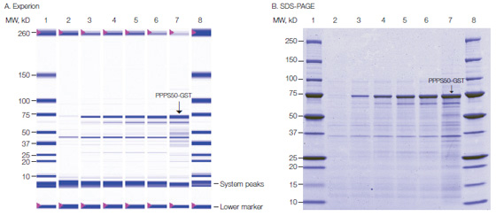
Sample Analysis (Proteins)
http://www.aesociety.org/areas/pdfs/Garfin_1DE_WebArticle9-07.pdf

Slide 17
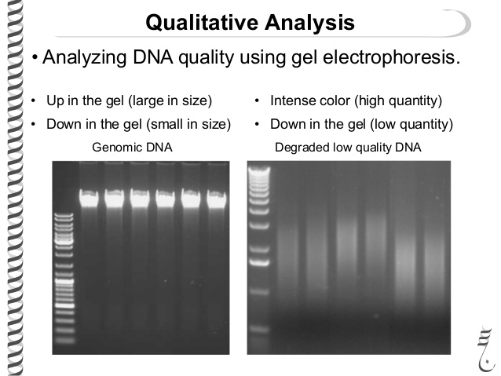
Sample Analysis (DNA)

Slide 18
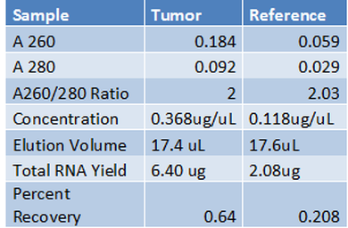
Sample Analysis (RNA)
The A260 value for our tumor RNA sample was 0.184 which we used to calculate the RNA concentration using Beer's law of A=EBC. With an absorbance value of 0.184, an E value of 50 for RNA, and a path length of 1cm, the concentration of RNA for our tumor sample is 0.368ug/uL. With our elution volume of 17.4 uL our total tumor elution mass was 6.40 ug With a A260 value of 0.059 for our reference value, using Beer's law we get a concentration of 0.118 ug/uL. With an elution volume of 17.6 uL, our total reference mass is 2.08 ug.

Slide 19
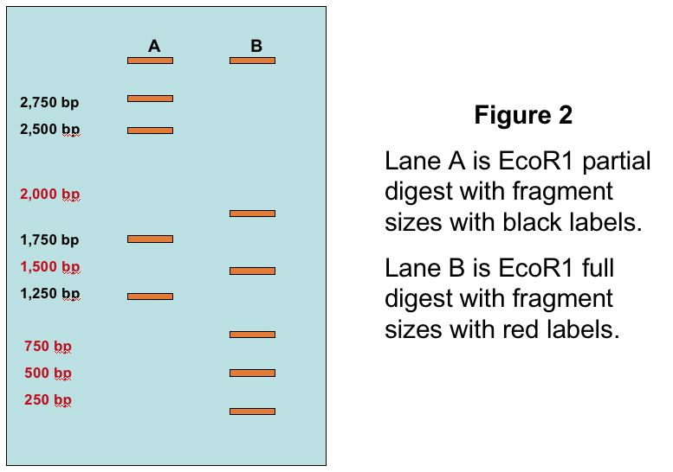
Practice Problem
Estimate the values of the bands in Lane B.

Slide 20
Practice Problem

Slide 21
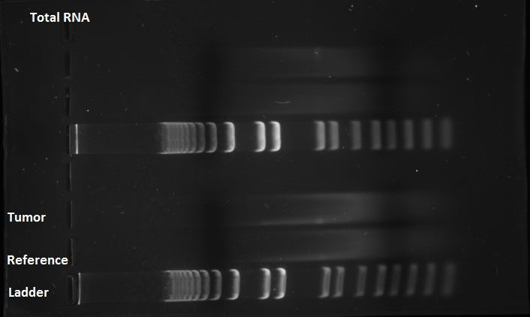
Practice Problem
What is the problem with the tumor and reference samples?

Slide 22
Practice Problem
The tumor and reference samples are degraded. Their low quality would make analysis very difficult.

Slide 23
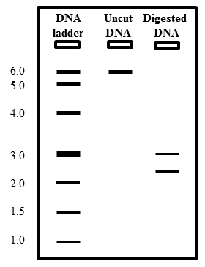
Practice Problem
Estimate the value of the circled band of Digested DNA.

Slide 24
Practice Problem
Answer: about 2.5

Slide 25
Uses of Gel Electrophoresis
DNA Analysis
Forensics
Paternity testing
Protein Analysis
Doctors
Antibiotic Analysis
Doctors
Medical Researchers
Vaccine Analysis
Pharmacology

