Slide 1
Exit Question: Hydrogen Bonding
Research on your own the difference between “intermolecular forces” and “intramolecular forces”. Explain how they are different.
Using H₂O as your example, draw three water molecules. Orient them as they would bond and label where the intermolecular forces exist and where the intramolecular forces exist.

Slide 2
Hydrogen Bonding Demo
Draw a picture and explain what you observe.

Slide 3
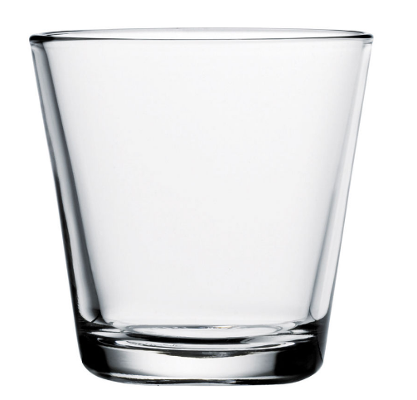
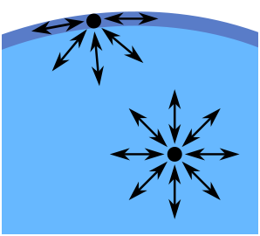
Hydrogen Bonding Demo
Why doesn’t the water “fall out”?
Answer: Hydrogen Bonding
Because of intermolecular attractions, a particle is most stable (lowest potential energy) when it has the maximum number of neighbors. Circle the particle below that has the higher energy.

