Slide 1
Mass
Spectrometry
Instrument
Analysis
By Arturo Perez-Hunt

Slide 4
A Salty Example
The sample should be solvent-free and pure with no excess salts in the sample, and should be weighed out in a small screw-top vial. Using Salt as an example, Salt is separated into electrically charged ions, Na+ and Cl-. The ions pass through the analyzer part of the spectrometer, which contains electric and magnetic fields. These fields put force on the ions changing the speed and the direction. The lighter the ion the more it is deflected by the magnetic field. Then the detector records the abundance of each ion type determining the chemical element composition of the original sample and the isotopic compositions. In other words, it separates it determines how much of each ion is contained in a solution.

Slide 5
Uses
It is used for drug discovery to determine the structures of drugs and metabolites (sugars, starches, and amino acids) and screen for metabolites in a biological system.
Clinical Testing to perform forensic analyses (confirmation of drug abuse) and detect disease biomarkers.
In Genomics to sequence oligonucleotide. (Oligonucleotides are used to research genetic testing and forensics.)

Slide 6
Explaining Data
M/z represents the specific mass per charge. The greater the length of the bar the more abundant with the greatest peak (100) being the base peak. When put into the machine, the ions are separated into molecular ions and ion fragments. The simpler the original molecule the simpler the graph, for example CO₂. CO₂ contains ion fragments of CO and O, which measure 28 and 16, and the molecular ion of 44 which creates three separate lines. However, since the molecular ion appears more than the fragments (bigger line/more abundant) then we can determine the actual m/z of the ion is trully 44. Different combinations with varying amounts of fragments produce different results. This is why Propane can equal the have the same recorded m/z as Carbon Dioxide. Put simply, the ion that appears the most is the molecular ion (biggest line) and the other bars are variations of the ion that can occur but are not as likely.

Slide 7
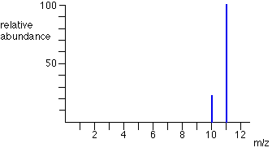
Examples
Look at the periodic table, what element has a molar mass of 11?
What does 10 represent if it is the same element?

Slide 8
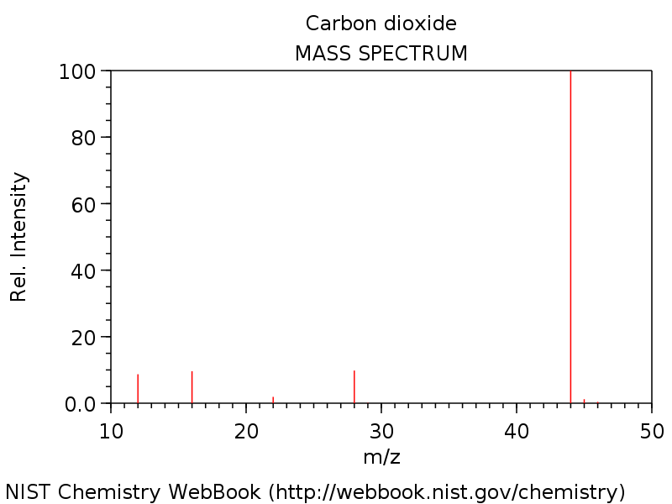
More Examples
The “big line” represents CO₂ which is 44m/z. What do the other lines represent?
Why would they be shown?

Slide 9
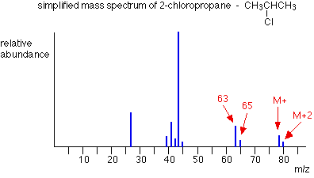
EVEN MORE Examples
The mass of Chlorine is 35. Write the ions represented by the lines at 28, 41, 63 using only carbon, hydrogen , and chloride.
M stands for mass. What is the mass of 2-chloropropane using only the graph.

Slide 10
Answers
Boron…. An Isotope
Carbon (12) , Oxygen (16), CO (28), and Isotopes
C₂H₄, ClH₆ , C₂H₄Cl … 78

Slide 11
Sources
http://www2.chemistry.msu.edu/faculty/reusch/virttxtjml/spectrpy/massspec/masspec1.htm
http://www.chemguide.co.uk/analysis/masspec/howitworks.html
https://www.youtube.com/watch?v=ookUh91aUCQ
https://masspec.scripps.edu/mshistory/whatisms_toc.php
https://www.youtube.com/watch?v=mBT73Pesiog

