Slide 1
Agenda
You will prepare
3 multi-flow charts
3 brainstorms (bubble map)
3-4 paragraph essay (explanation)

Slide 2
Reading Assignment: Equilibrium
Read pgs. 816-818 silently to yourself.
You will have 10 minutes to read. This is silent and by yourself.

Slide 3
Reading Assignment: Equilibrium
The second time you read you will:
#Number the paragraphs
Circle chemical reactions
Underline key terms
A key term is defined as: repeated word, defined by the author, relevant to our reading purpose, used to explain or represent

Slide 4
Reading Assignment
Reading Purpose:
Explain how Le Chatelier’s Principle is relevant to our bodies in cellular respiration and hemoglobin production using chemical equations. Provide two examples of how the equilibrium will shift and why.
Explain how the concept of equilibrium maintains the pH of blood, preventing it from getting too acidic or basic.
Explain how the equilibrium is disrupted by hyperventilation and acidosis.

Slide 5
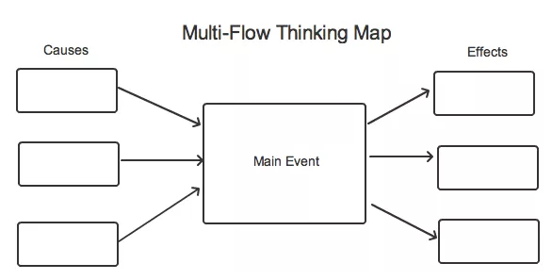
Let’s Prepare!
Draw and Organize a Multi-Flow Map.

Slide 6
Let’s Prepare!
Le Chatelier’s Principle and cellular respiration

Slide 7
Let’s Prepare!
Le Chatelier’s Principle and Hemoglobin Production

Slide 8
Your Turn!

Slide 9
Let’s Prepare!
Here are some guiding questions?
What is the purpose of cellular respiration?
What do we take in and what do we expel?
What is the main product of cellular respiration?
What is the chemical equation for cellular respiration?
If more sugar is added, which direction will the equilibrium shift and why?
Cellular Respiration

Slide 10
Let’s Prepare!
How does our body use hemoglobin?
What equation represents the equilibrium of hemoglobin?
If a person is deprived of oxygen, which direction does the equilibrium shift and why?
What is another way to make the reaction shift direction?
Hemoglobin

Slide 11
Let’s Prepare!
What equation represents how our blood controls pH?
What is the effect of two much acid? Direction of eq? Why?
What is the effect of too much CO₂? Direction of eq? Why?
What does it mean to hyperventilate and how is eq. disrupted? What is the effect on the person? How can hyperventilation be corrected?
What is acidosis? What is the effect on eq? How is pH of blood effected?
pH of blood

