Slide 1
Salts
1. Draw the 5 petri dishes and label accordingly. Record your observations.
NaHCO₃
AlCl₃
NH₄Cl
Na₃PO₄
NaCl

Slide 2
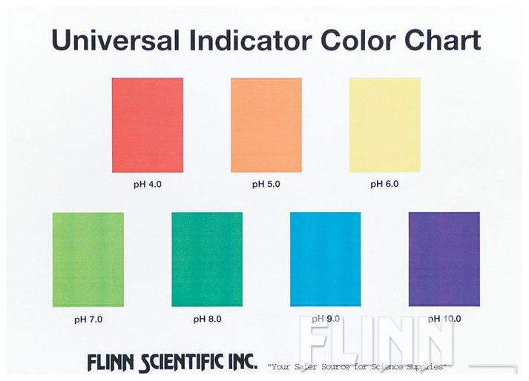

Slide 3
Salts
2. Record the color of the salt after it is added to water and indicate the pH associated with the pH value.
3. How is it that salts can be acidic or basic? Justify.

Slide 4
Salts
Salt | Parent Acid | Acid Strength | Parent Base | Base Strength | Type of Salt
AlCl₃
Na₃PO₄
NH₄Cl
NaCl
NaHCO₃

