Slide 1
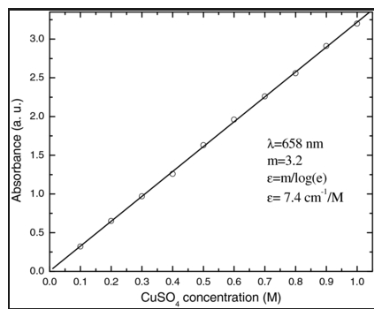
What’s wrong with my answer?
1.Define Beer’s Law.
2.Explain the purpose of a calibration curve.
Use the graph below for questions 3 and 4.

