Slide 1
X-Ray Diffraction
Taylor Intal
AP Chemistry
Period 2

Slide 2
What is X-ray diffraction?
X-ray diffraction (XRD) is a rapid analytical technique primarily used for phase identification of a crystalline material and can provide information on unit cell dimensions. The analyzed material is finely ground, homogenized, and average bulk composition is determined. An amorphous sample shows a broad “halo” like pattern. Crystalline samples have the peaks within them.

Slide 3
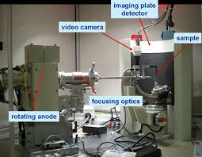
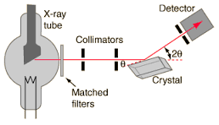
Diagrams

Slide 4
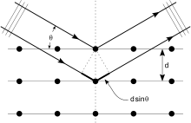
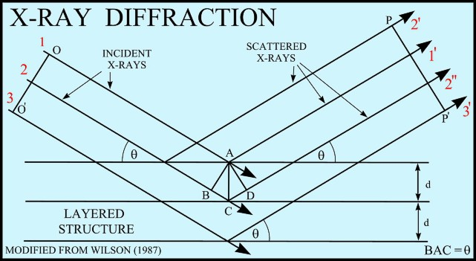
Diagrams

Slide 5
Step by Step (Preparation)
Obtain a few tenth of a gram (or more) of the material, as pure as possible.
Grind sample into a fine powder, typically in a fluid to minimize including extra strain (surface energy) that can offset peak positions, and to randomize orientation. Powder less than ~10 μm(or 200-mesh) in size is preferred.
Place into a sample holder or unto the sample surface:
Smear uniformly onto a glass slide, assuring a flat upper surface
Pack into a sample container
Sprinkle on double sticky tape
Care must be taken to create a flat upper surface and to achieve a random distribution of lattice orientations unless creating an oriented smear.

Slide 6
Step by Step
To collect data, the intensity of diffracted X-rays is continuously recorded as the sample and detector rotate through their respective angles.
A peak in intensity occurs when the mineral contains lattice planes with d-spacings appropriate to diffract X-rays at that value of θ.
Although each peak consists of two separate reflections (Kα1 and Kα2), at small values of 2θ the peak locations overlap with Kα2appearing as a hump on the side of Kα1.
Greater separation occurs at higher values of θ.
Typically these combined peaks are treated as one. The 2λ position of the diffraction peak is typically measured as the center of the peak at 80% peak height.
Each peak represents the compound.

Slide 7
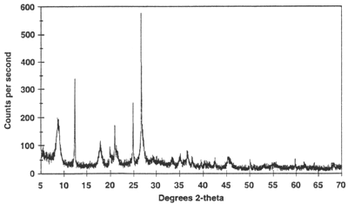
Sample Analysis
A detector records and processes this X-ray signal and converts the signal to a count rate which is then output to a device such as a printer or computer monitor.
Copper

Slide 8
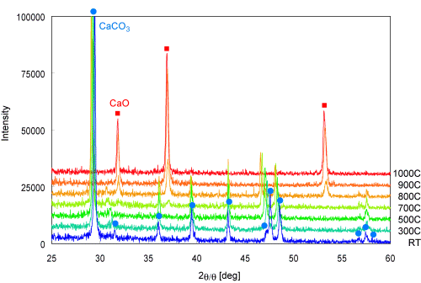
Sample Analysis
This is a different example of what it looks like when samples are under extreme heat. The intensity is much higher but the rotation stays the same.
This is of CaCO2 and CaO.

Slide 9
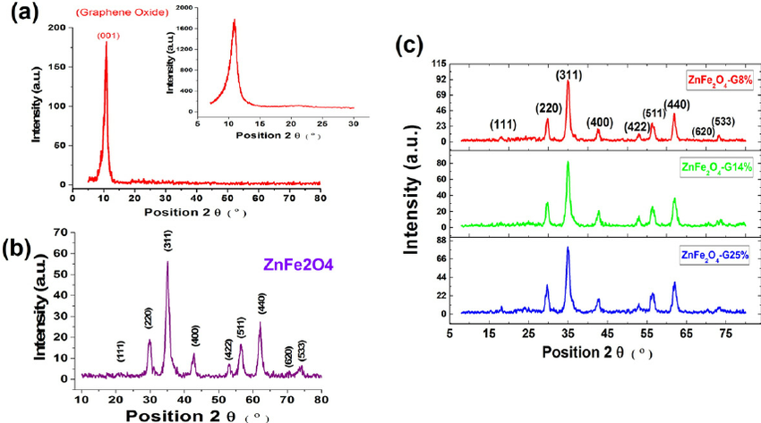
Sample Analysis
Fig. A is graphene oxide with a 001 peak.
Fig. B is pristine ZnFe2O4
Fig. C is ZnFe2O4 with functionalized graphene samples with 8%, 14%, and 25%.

Slide 10
Sample Question
Whether a sample is amorphous or crystalline, which parts are the only entities the yield sharp peaks?
(u rock Mrs. Donohue)

Slide 11
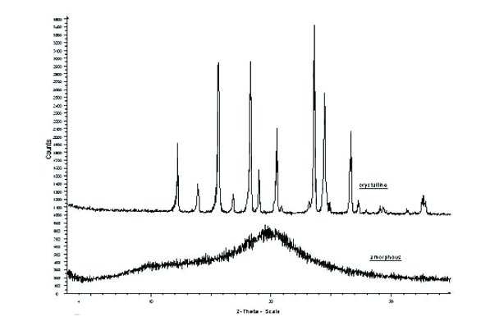
Sample Question
2. Which graph shows a crystalline substance and which graph shows an amorphous substance?

Slide 12
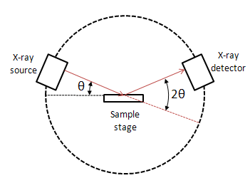
Sample Question
3. Label the inside of the instrument.

Slide 13
Answers
Crystalline would show sharp peaks
The top graph is crystalline; the bottom graph is amorphous.

Slide 14
Industry
The oil industry uses X-ray diffraction due to its encounter with a wide variety of rocks, scales, cements, cuttings, and muds throughout drilling process. X-ray diffraction is used to identify the phases of the commonly identified solids. Three phases are identified in the figure below; the major is a barite phase and the two minor phases consist of calcite and quartz. The primary goal of this application is to quickly identify the phases contained within the sample material.

Slide 15
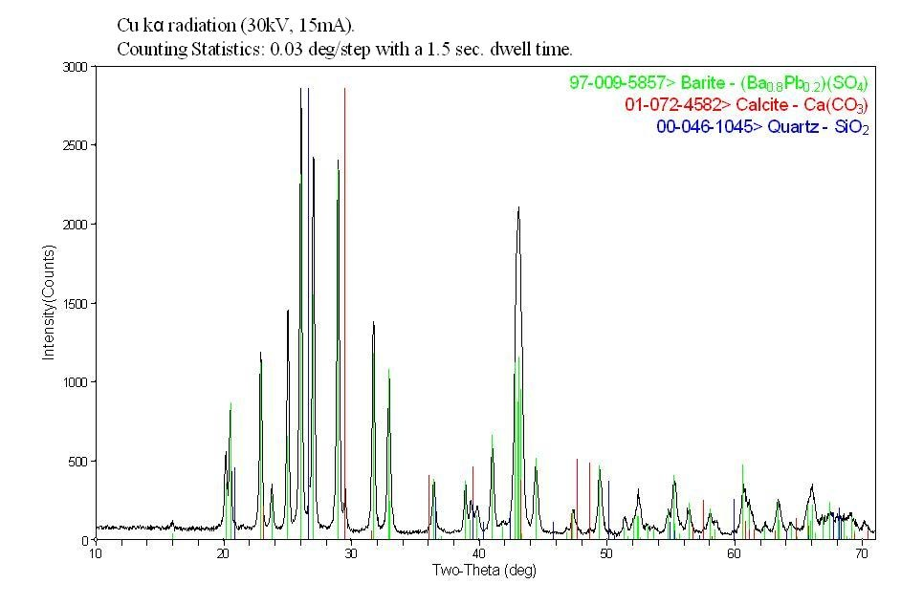
Industry

Slide 16
Sources
X-ray Powder Diffraction
Industry
Sample Analysis
Sample Questions

