Slide 1
Geiger Counter
Justin Rouleau

Slide 2
What is it?
An instrument that detects radioactivity
Most detect Gamma and X-rays, while some also detect Alpha and Beta radiation
consists of a Geiger-Mueller tube, a visual readout, and an audio readout.
Each click represents a particle count
Digital Geiger counters show particle count on LCD screen

Slide 3
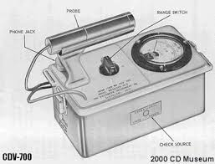
Diagram outside
Probe
Range Switch
Phone Jack
Check Source

Slide 4
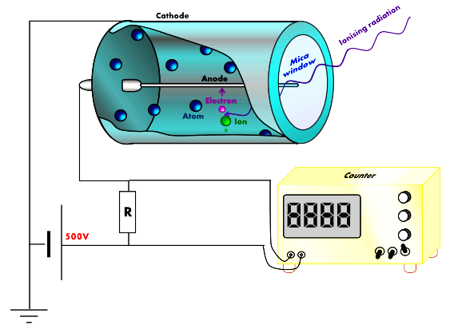
Inside

Slide 5
How does it work?
Radiation moves around randomly outside the detector tube.
Some of the radiation enters the window at the end of the tube
When radiation collides with gas molecules in the tube, causing ionization, some of the gas molecules are turned into positive ions and electrons.
The positive ions are attracted to the outside of the tube.
The electrons are attracted to metal wire running down the inside of the tube maintained at a high positive voltage.
Many electrons travel down the wire making a burst of current in a circuit connected to it.
The electrons make a meter needle deflect and you can hear a loud click every time particles are detected. The number of clicks you hear gives a rough indication of how much radiation is present.

Slide 6
Radiation
Measured in CPM (counts per minute), “It is the number of atoms in a given quantity of radioactive material that are detected to have decayed in one minute.”
100 CPM or higher puts one in danger of the effects of radiation
Radiation dosage is a measure of risk (biological harm to tissue)
Absorbed radiation is measured in slevert (Sv)
One Sv is enough to cause radiation sickness and cellular mutation

Slide 7
Radiation Data
Days compared with the avg. annual human exposure (U.S.)
207 (at 100 CPM)
42 (at 500 CPM)
14 (at 1,500 CPM)
2 (at 10,000 CPM)
Days to receive chronic dose for increase cancer risk of 1 in a 1,000
432 (at 100 CPM)
86 (at 500 CPM)
28 (at 1,500 CPM)
4 (at 10,000 CPM)
Days for earliest onset of radiation sickness
25,937 (at 100 CPM)
5,187 (at 500 CPM)
1,729 (at 1,500 CPM)
259 (at 10,000 CPM)

Slide 8
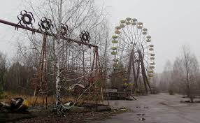
Example 1: Chernobyl
The Chernobyl accident in 1986 was the result of a flawed reactor design that was operated with inadequately trained personnel.
The resulting steam explosion and fires released at least 5% of the radioactive reactor core into the atmosphere and downwind – some 5200 PBq (I-131 eq).
Two Chernobyl plant workers died on the night of the accident, and a further 28 people died within a few weeks as a result of acute radiation poisoning.
UNSCEAR says that apart from increased thyroid cancers, "there is no evidence of a major public health impact attributable to radiation exposure 20 years after the accident."
Resettlement of areas from which people were relocated is ongoing. In 2011 Chernobyl was officially declared a tourist attraction.

Slide 9
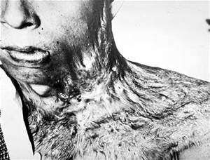
Example 2: Hiroshima and Nagasaki
The damaging penetration of radiation would be possible from three sources:
From the high-frequency radiations, whether neutrons, gamma rays, or other unspecified rays, released in the chain reaction of the bomb.
From lingering radioactivity from deposits of primary fission products scattered in the explosion.
From induced radioactivity in the bombed area, caused by interaction of neutrons with matter penetrated.

Slide 10
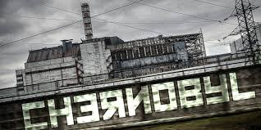
Cont.
The radiation apparently had no lasting effects on the soil or vegetation: Seeds later planted within a few hundred feet of ground zero grew normally. Examination of subsurface soil in the immediate area showed presence of earthworms and other life only a few inches below the surface. The effect on human procreation is as yet undetermined, but pregnant women within a mile of ground zero showed an increased number of miscarriages, and there was in most cases a low sperm count among men in the same area. Stories of harmful effects on people who came into the area after the explosion have been disproved by investigation.
The rays proved lethal for an average radius of 3,000 feet from ground zero. They caused loss of hair up to 7,500 feet and occasionally beyond, and other mild effects up to almost 2 miles.

Slide 11
Example 3: Fukushima
The disaster in Fukushima has shown to already be affecting the surrounding plants and animals. After the earthquake in 2011, radioactive material made contact with the air and spread into the surrounding environment. The researchers gave an example of the pale grass blue butterfly, which is a prevalent type of butterfly species found in Japan. The effect of radiation in the Fukushima region has led to the reduction in size of this species of butterfly. The pale grass blue butterfly is also experiencing slow growth and a high mortality rate in the region surrounding the Fukushima nuclear plant.

Slide 12
Possible experiments:(4,5, and 6)
Background Radiation: Small amounts of radioactivity surround us, coming from minerals in the earth, from the sky, and the things we use every day. This is called background radiation. You can measure it with a Geiger counter. A counter with a numerical display instead of a dial meter will make this easier. Simply record the total number of Geiger counter events for a brief period, such as a minute. Repeat the process a few times and find the average. Divide this number by the number of seconds per measurement to find the radiation rate.
Half Life:A few ccs of a salt water solution passed through a cesium-137 capsule will flush radioactive barium into the water. Measure the barium right after it’s prepared. Every minute, record Geiger counter clicks for 10 or 15 seconds. After about a half-hour, the barium sample will decay to very low levels. When the the instrument no longer detects radiation counts greater than background, they can stop. Because background radiation will inflate counts, one must subtract the background rate from the data taken. Finally, plot results on graph paper to see the exponential decay curve. When the experiment is done, safely pour the solution down the drain.
Shielding:Obtain a variety of metal, plastic and paper objects to demonstrate the shielding power of materials. Lead bricks, sheet, or foil will be handy for this. Basically sources having different kinds of radiation: alpha, beta and gamma. You can readily show you can block alpha radiation with thin cardboard or plastic. An eighth- to a quarter-inch of metal will block beta radiation. Lead bricks will stop some but not all gamma radiation. Repeat previous half life experiment with a shield to show the effectiveness of that substance as a shield.

Slide 13
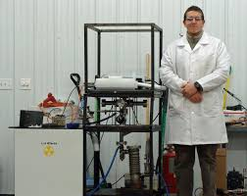
Industry
Geiger counters are commonly used for measuring transformers and power lines. They make sure that there isn’t too much ionizing radiation being emitted. Another industrial purpose is the measurement of electronics, making sure they are safe for the general public and not too radioactive. They are used to find both radiation and magnetic flow.

Slide 14
Sources
http://www.geigercounters.com/
http://physics.nyu.edu/~physlab/Classical%20and%20Quantum%20Wave%20Lab/ar1.pdf
http://modernsurvivalblog.com/nuclear/radiation-geiger-counter-the-radiation-network/
http://www.world-nuclear.org/information-library/safety-and-security/safety-of-plants/chernobyl-accident.aspx
http://www.ibiblio.org/hyperwar/AAF/USSBS/AtomicEffects/AtomicEffects-3.html
http://www.techtimes.com/articles/13316/20140818/fukushima-disaster-show-effects-of-radiation-in-animals-plants-study.htm
http://www.industrial-needs.com/measuring-instruments/geiger-counters.htm

