Slide 1
High Performance Liquid Chromatography (HPLC)
Alondra Ponce

Slide 2
What the heck is this?
Technique used to separate, identify, and quantify each component in a mixture through adsorption
The binding of molecules to a surface
Every compound interacts with other chemical species in a characteristic manner
Basically a highly improved version of column chromatography
Instead of a solvent being allowed to drip through a column under gravity, it’s forced through under high pressures of up to 400 atm, which makes it much faster
Stationary phase: a solid, or a liquid supported on a solid
Mobile phase: liquid or gas (solvent)

Slide 3
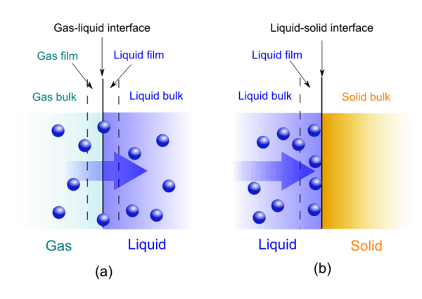
Absorption
Adsorption

Slide 4
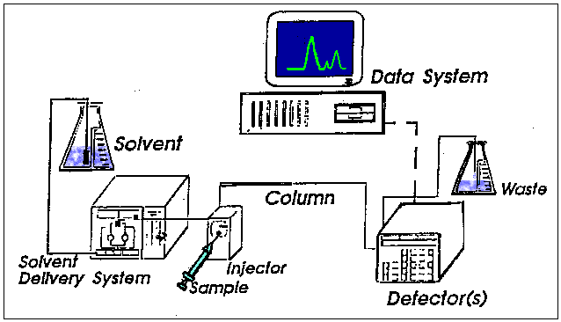

Slide 5
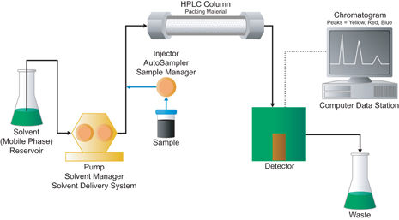

Slide 6
Preparation & Analyzation
A reservoir holds the solvent [called the mobile phase, because it moves].
A high-pressure pump [solvent delivery system or solvent manager] is used to generate and meter a specified flow rate of mobile phase, typically milliliters per minute.
An injector [sample manager or autosampler] is able to inject the sample into the continuously flowing mobile phase stream that carries the sample into the HPLC column.
column contains the chromatographic packing material needed to effect the separation. This packing material is called the stationary phase because it’s held in place by the column hardware.
A detector is needed to see the separated compound bands as they elute from the HPLC column [most compounds have no color, so we can’t see them with our eyes].
The mobile phase exits the detector and can be sent to waste, or collected. When the mobile phase contains a separated compound band, HPLC provides the ability to collect this fraction of the eluate (or mobile phase) containing that purified compound for further study. This is called preparative chromatography [discussed in the section on HPLC Scale].

Slide 7
Continued
Retention time: time taken for a particular compound to travel through the column to the detector
This time is measured from the time at which the sample is injected to the point at which the display shows a maximum peak height for that compound.
Different compounds have different retention times. For a particular compound, the retention time will vary depending on:
the pressure used (because that affects the flow rate of the solvent)
the stationary phase (not only what it’s made of, but also particle size)
the exact composition of the solvent
the temperature of the column

Slide 9
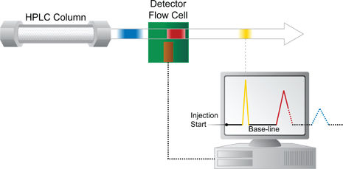
Notes:
How peaks are created.

Slide 10
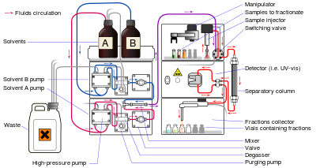

Slide 11
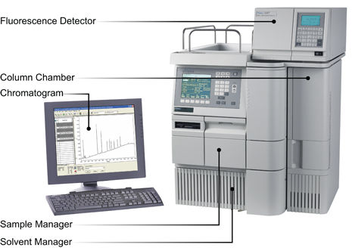

Slide 12
Applications
Used for the separation of almost all other compound varieties.
Separates:
aromatic hydrocarbons
amines, sugars, lipids, and even
pharmaceutically compounds such as vitamins
amino acids, peptides, and proteins (protein shake)
molecules of biological origin (dna sequencing)
Food analysis: (example) determination of caffeine content in coffee to guarantee purity and quality

Slide 13
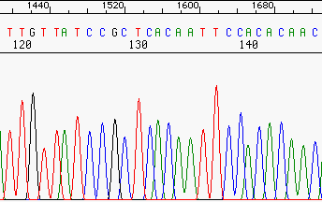
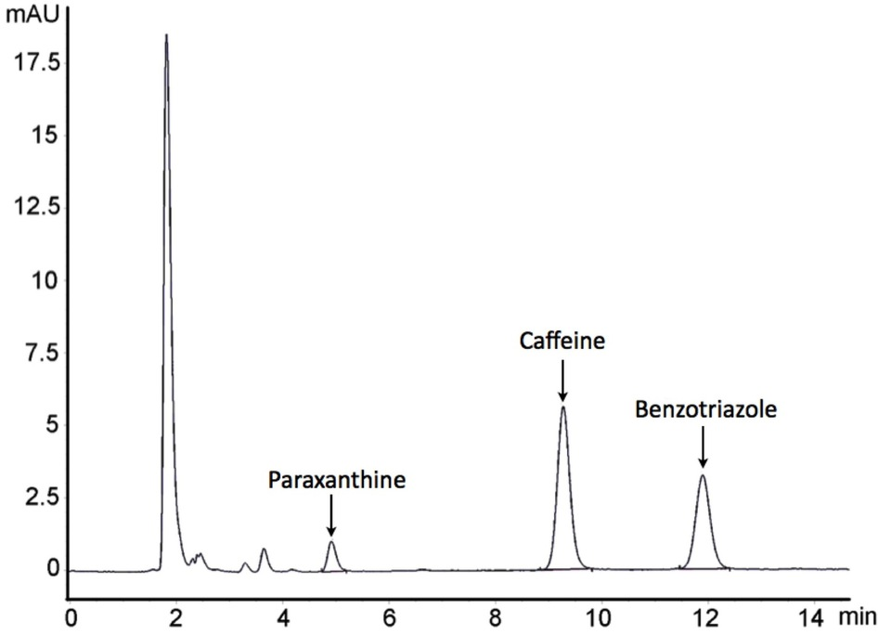
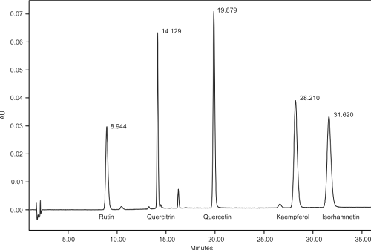
Examples
Notes:
Label Retention Time, which one is more polar, and which one has higher concentration

Slide 14
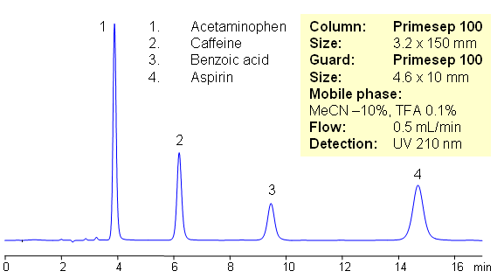
Practice Problems
Which can be used as a mobile phase in HPLC applications?
Any compound with solubility in liquid
Any compound with limited solubility in liquid
Any compound with non-solubility in liquid
All of the above
Notes:
The more time it takes, it has more attraction to the stationary phase. The height tells you the concentration. Which one has the highest concentration? (whichever has more area under the curve)

Slide 15
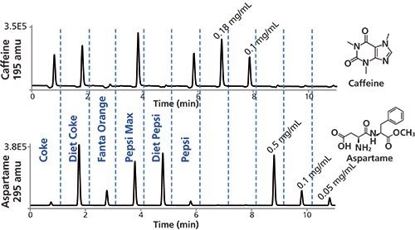
Continued

Slide 16
References
http://www.chemguide.co.uk/analysis/chromatography/thinlayer.html#top
http://ks.water.usgs.gov/pubs/reports/wrir.99-4018b.kah.html#HDR5
https://www.beckmancoulter.com/wsrportal/wsr/index.htm
http://hiq.linde-gas.com/en/analytical_methods/liquid_chromatography/high_performance_liquid_chromatography.html

