Slide 1
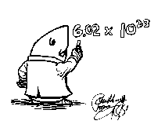
Mole Practice
Practice converting the following:
3.00 mol NH₃ = ____g
9.02 mol H₂O = ____g

Slide 2
Mole Practice
3. 0.2 g SO₃ = ____mol
4. 0.0106 g NO₂ = ____mol

Slide 3
Mole Practice
5. 6.0 g MgCl₂ = ____atoms
6. 8.00 g NaOH = ____atoms

Slide 4
Mole Practice
3.25 x 10²⁴ atoms of calcium = ____grams
10.0 x 10²² atoms of I₂ =___grams

Slide 5
Mole Practice On Your Own
9. 2.9 x 10²⁵ atoms of calcium = ____grams
10. 43 x 10²¹ atoms of I₂ =___grams

