Slide 1
Scanning Electron Microscope
Eee-Jay Rodriguez

Slide 2
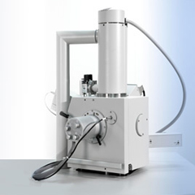
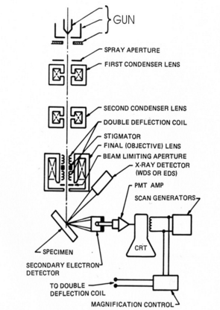
The Structure of the Microscope
Inside
Outside

Slide 3
The process of the SEM
At the top of the microscope, is the electron gun. It contains a hot cathode, which is usually a tungsten filament. A current then runs through the filament, which in return, makes it heat up and produce light and an electron cloud. The cloud is produced but it is scattered everywhere, which cannot be used as a beam yet. This is where the two plates with a charge comes in. The anode plate has a positive charge and an aperture which is supposed to attract the electrons from the electron gun. Even this is not sufficient enough, because the charge would only make the electrons spread throughout the plate. This is where the cathode plate with a negative charge focuses the electrons through the aperture of the anode plate. The negative charge makes a field that repels the electrons away from touching the anode plate, but at the same time the anode plate attracts the electrons to go through the two plates plates. The fields do two things to the electrons. It makes the beam more focused and makes them travel at a faster speed. This comes into play when focusing the image produced from the SEM. Once the initial beam is produced, the electrons are still in a spread out formation once it has left the two plates. In order to make the ¨beam¨ more of a beam, lenses are needed. The lenses needed for the SEM are called electromagnetic lenses. These lenses are not really lenses although they still play the role of lenses as they still focus the electrons into a stronger beam. The lenses are actually not glass but they are coil wires around a metal cylinder. Then a current is run through the wires that will make them have a negative field around them causing the electrons to condense and make them go faster. The electrons are put through a couple more of these condenser (magnetic) lenses. After that, the electrons reach the final lens, which is special because it has a component called a stigmator. The stigmator reduces astigmatism by imposing a weak quadrupole field on the electrons. The way it works is that it pushes the beam of the electrons to be symmetrical to the optic axis, so that there is one primary output of electrons. Having multiple beams hitting the sample would make the image inaccurate. There is a final aperture, as a final limit on the size of the electron beam.

Slide 4
Preparing and analyzing the sample
A sample analyzed by a scanning electron microscope must be in a solid state. “Wet” samples (anything of organic composition, clay, coal, etc…) are things that cannot keep their state as a solid in low pressure and high temperatures. As an alternative, there are some scanning electron microscopes that are modified to examine “wet” samples. These microscopes have a lower vacuum and can operate with a weaker beam, and still produce a great image of the sample. The size of the sample must also be limited. The length and width must not exceed 10 cm. As well as the height is not to exceed 40 mm. If the sample is not in a modified microscope, it must be coated with an adhesive layer to prevent charge build-up, which will make the resolution of the image better. Once the sample has proven to be fit for examination, adjust the position of the sample to create a small aperture angle between the sample and the electron detectors. It is now time for the sample to be “hit” by the beam. There are three different scenarios going on with the electrons once they interact with the sample. The electrons can miss entirely, and can go through the sample without colliding or interfering with any atoms. Another situation is that the electrons enter the atom but are repelled by the nucleus and get “shot” back. These electrons are classified as “backscattered electrons”, and are collected by detectors. The other situation is when electrons from the beam collide with the sample’s electrons. This is possible because the electrons from the beam have a higher energy value than the electrons from the sample. The electrons from the beam can “knock” multiple electrons from the sample’s atoms, which makes the sample atoms’ electrons “fall” into lower orbitals, causing the atoms to release energy in the form of X-rays. The X-rays are recorded as either energy or wavelength, depending on the detectors used. The electrons that are “thrown” out of the atoms are called secondary electrons. These electrons are also recorded by the detectors as well. Detectors such as the EDS and WDS are used for qualitative and quantitative analysis of the sample. The EDS uses energy from the X-rays to determine elemental properties, while the WDS use the size of the X-rays’ wavelengths to determine the amount or relative abundance of a certain element in the sample. Once the detectors are finished recording data, the electrons travel through a precision signal amplifier, so that electrons can travel through the cathode tube to be displayed on a screen such as a monitor.

Slide 5
Industry
An industry that uses the SEM is the construction business. Since the SEM has a great quality of analyzing samples in great depth, construction workers use the microscope to make sure the compounds in cement are stable and durable. They use it as a safety measure, to make sure buildings are safety constructed. They take a sample of the concrete and analyze it to see the quality and strength of the concrete.
Concrete analyzed by the SEM

Slide 6
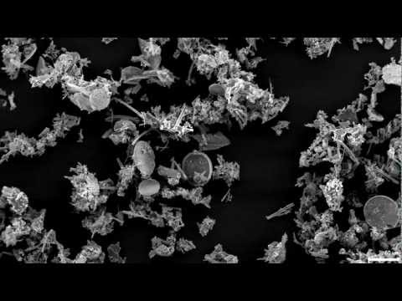
Video resolution of the SEM

Slide 7
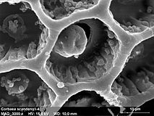
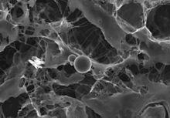
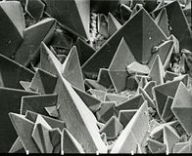
Analyzing more samples
Pollen
Circulating Human Blood
Cardiac Tissue
Surface of a Kidney Stone

Slide 8
Bibliography
http://serc.carleton.edu/research_education/geochemsheets/techniques/SEM.html
http://www.seallabs.com/how-sem-works.html
https://en.wikipedia.org/wiki/Scanning_electron_microscope

